Slide 1
Team RoadToGus Final Presentation – Week 8
AI Expenditure Planning Assistant (Built in IBM Watsonx Prompt Lab)

Slide 2
Who We Are
Jonathon — Research & Ideation
Wayne Lumpkin Jr. — Lead Designer & Prompt Engineer
Ryan Gilligan — Documentation & Insights
Aidan Keena — Technical Reviewer
Samalie Nakawuki — Scenario Writing & Testing

Slide 3
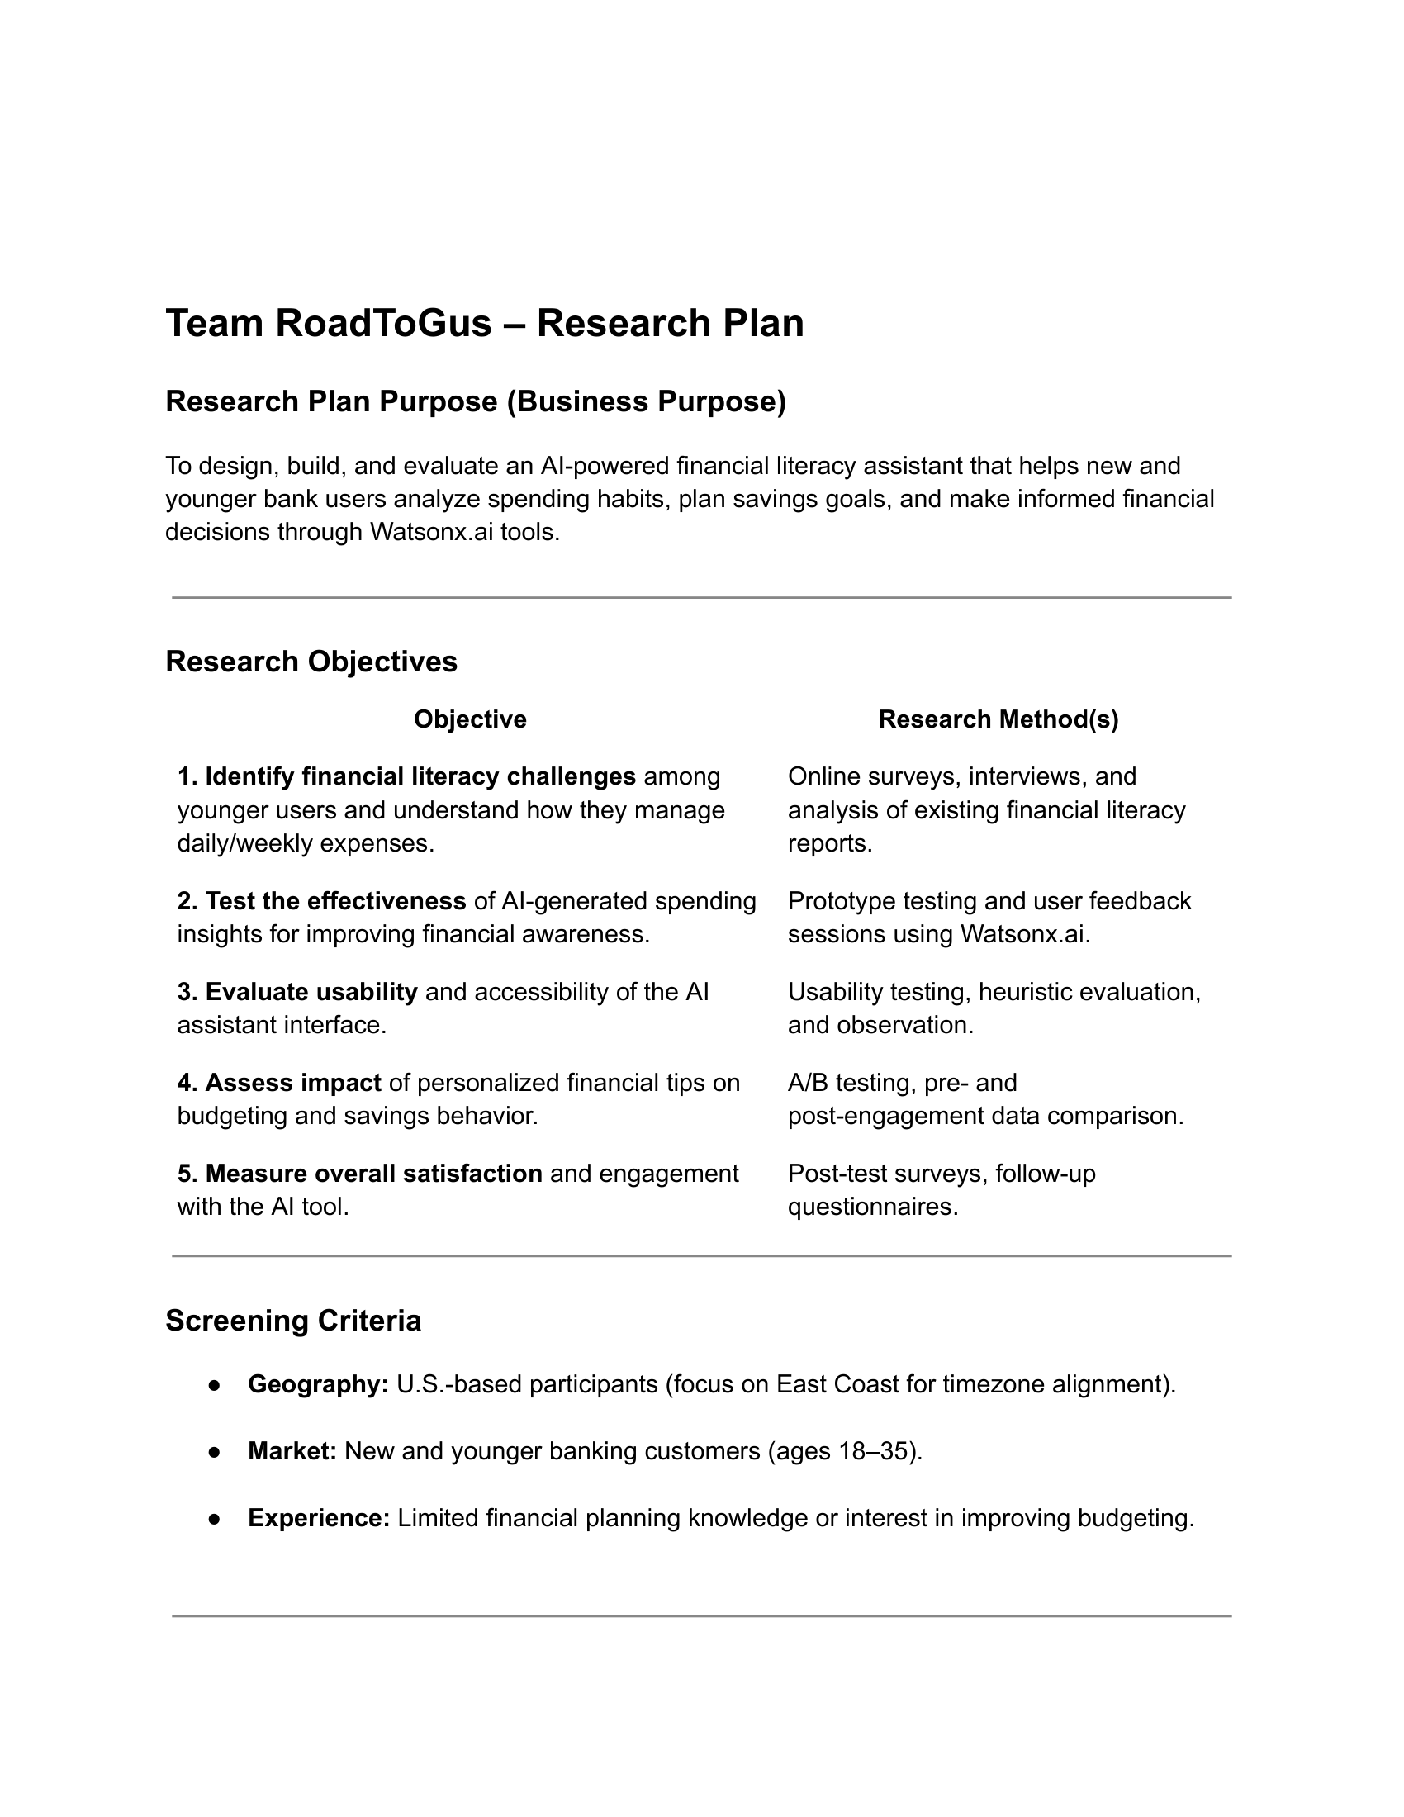
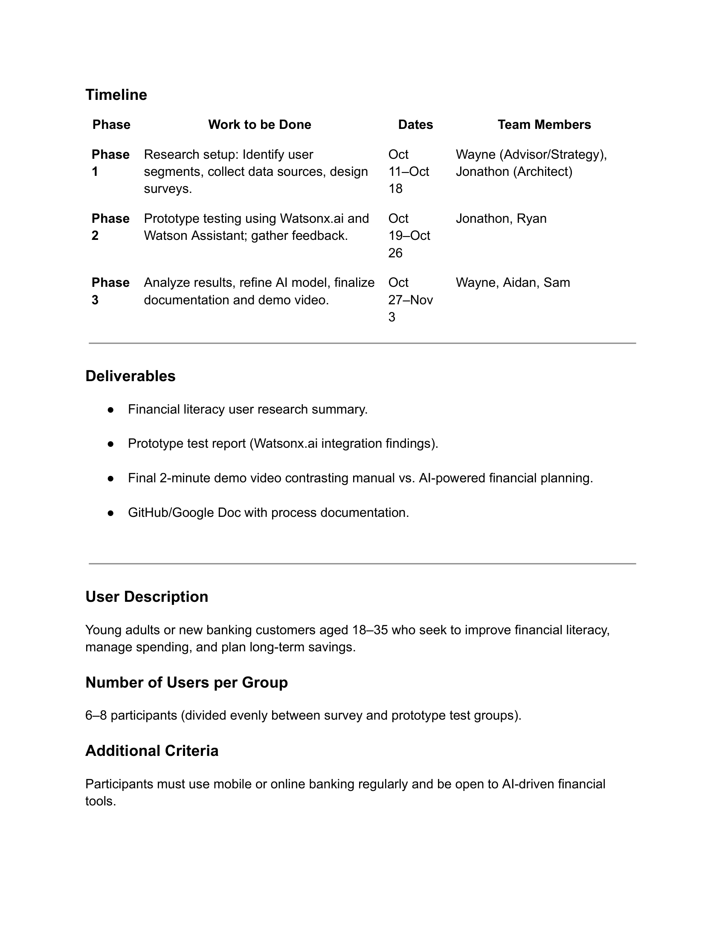
WEEK 1: Understanding the Problem
User Research Plan Slide

Slide 4
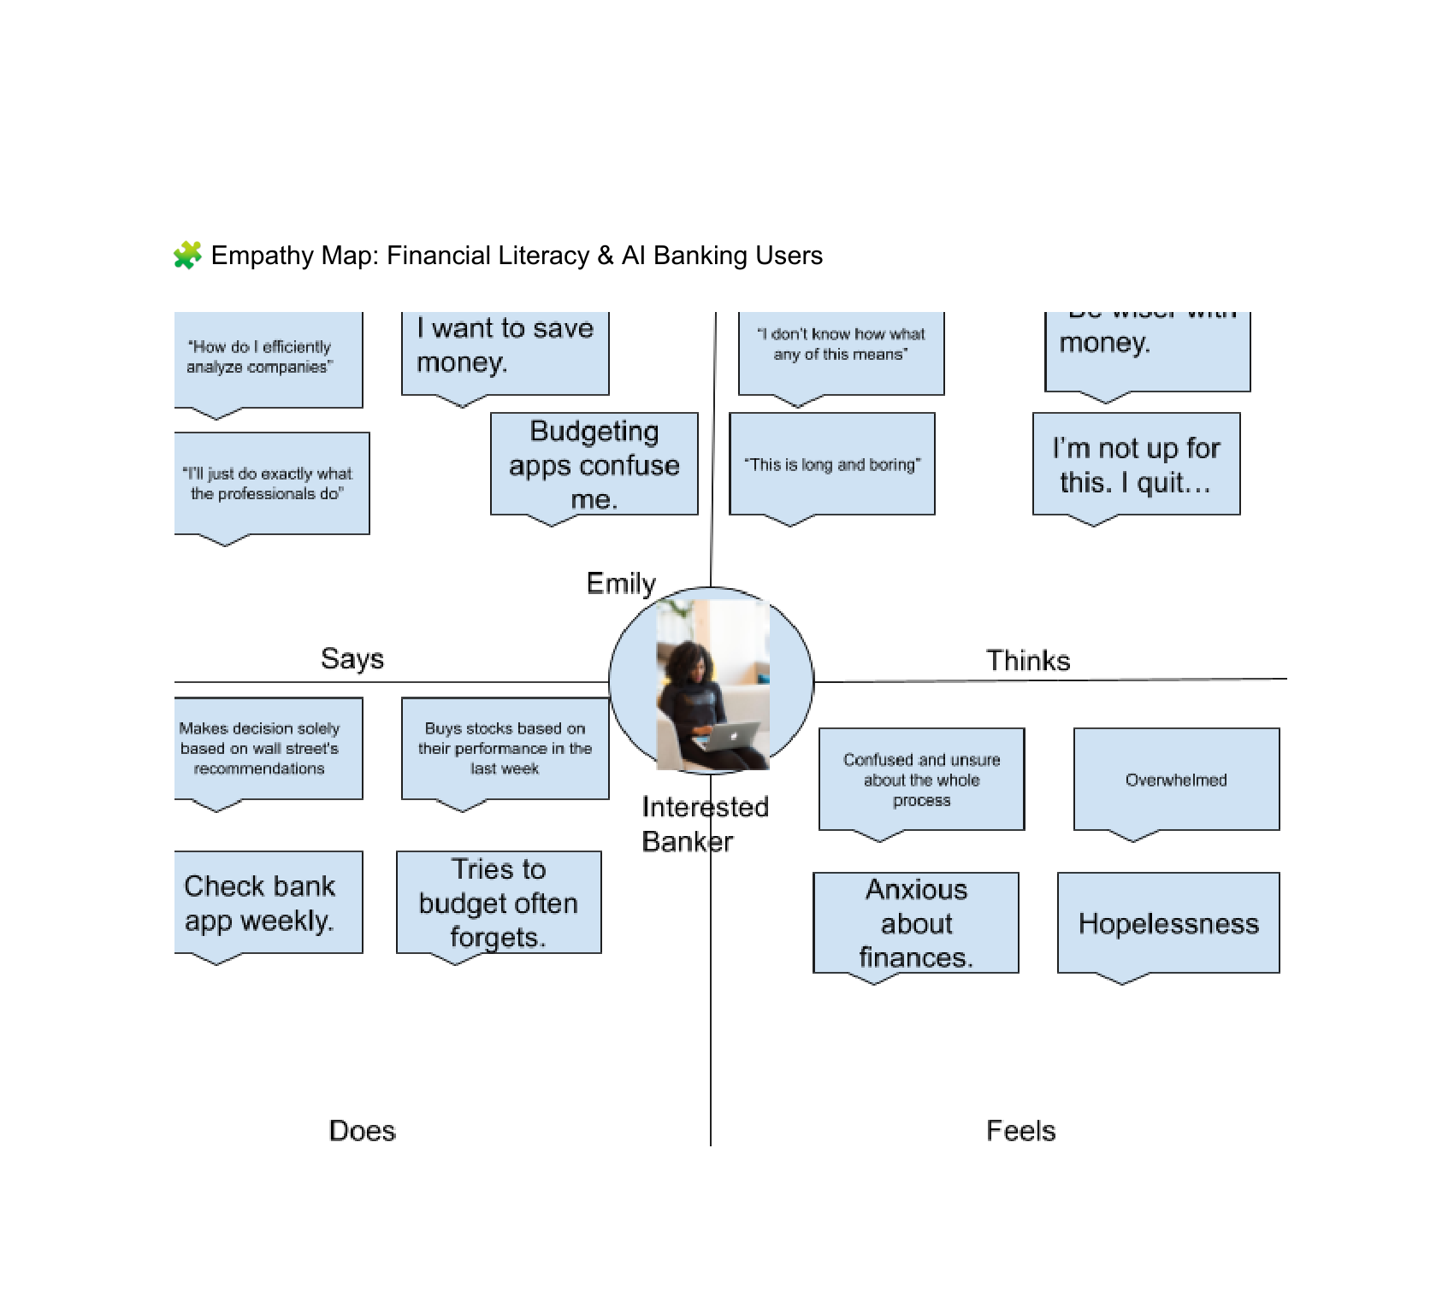
Empathy Map Slide

Slide 5
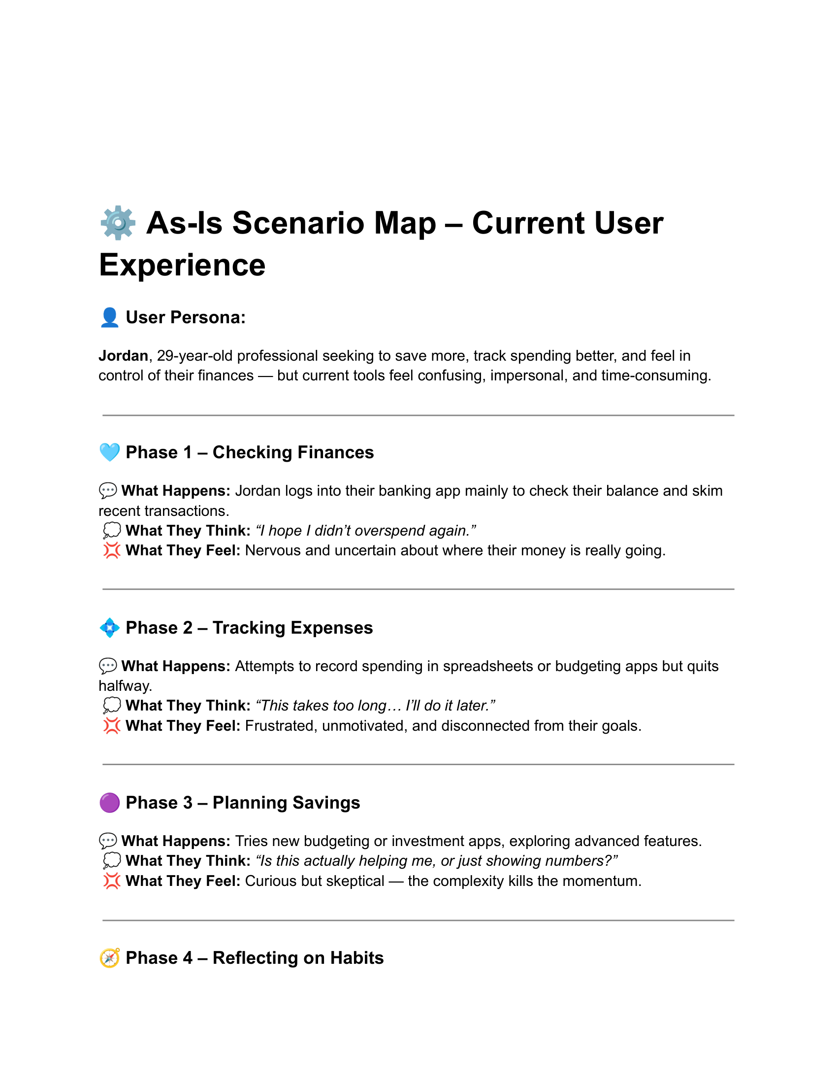
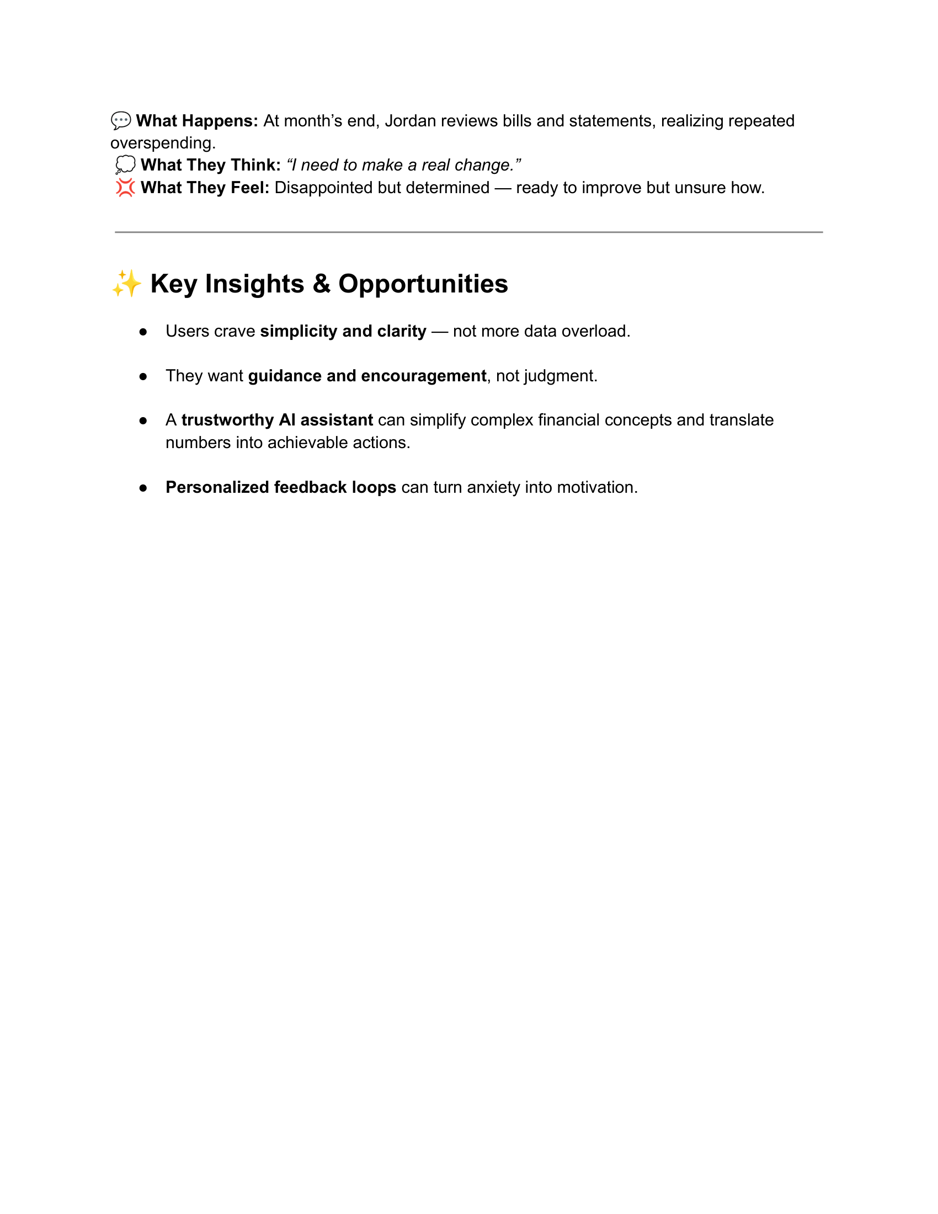
As-Is Scenario Slide

Slide 6
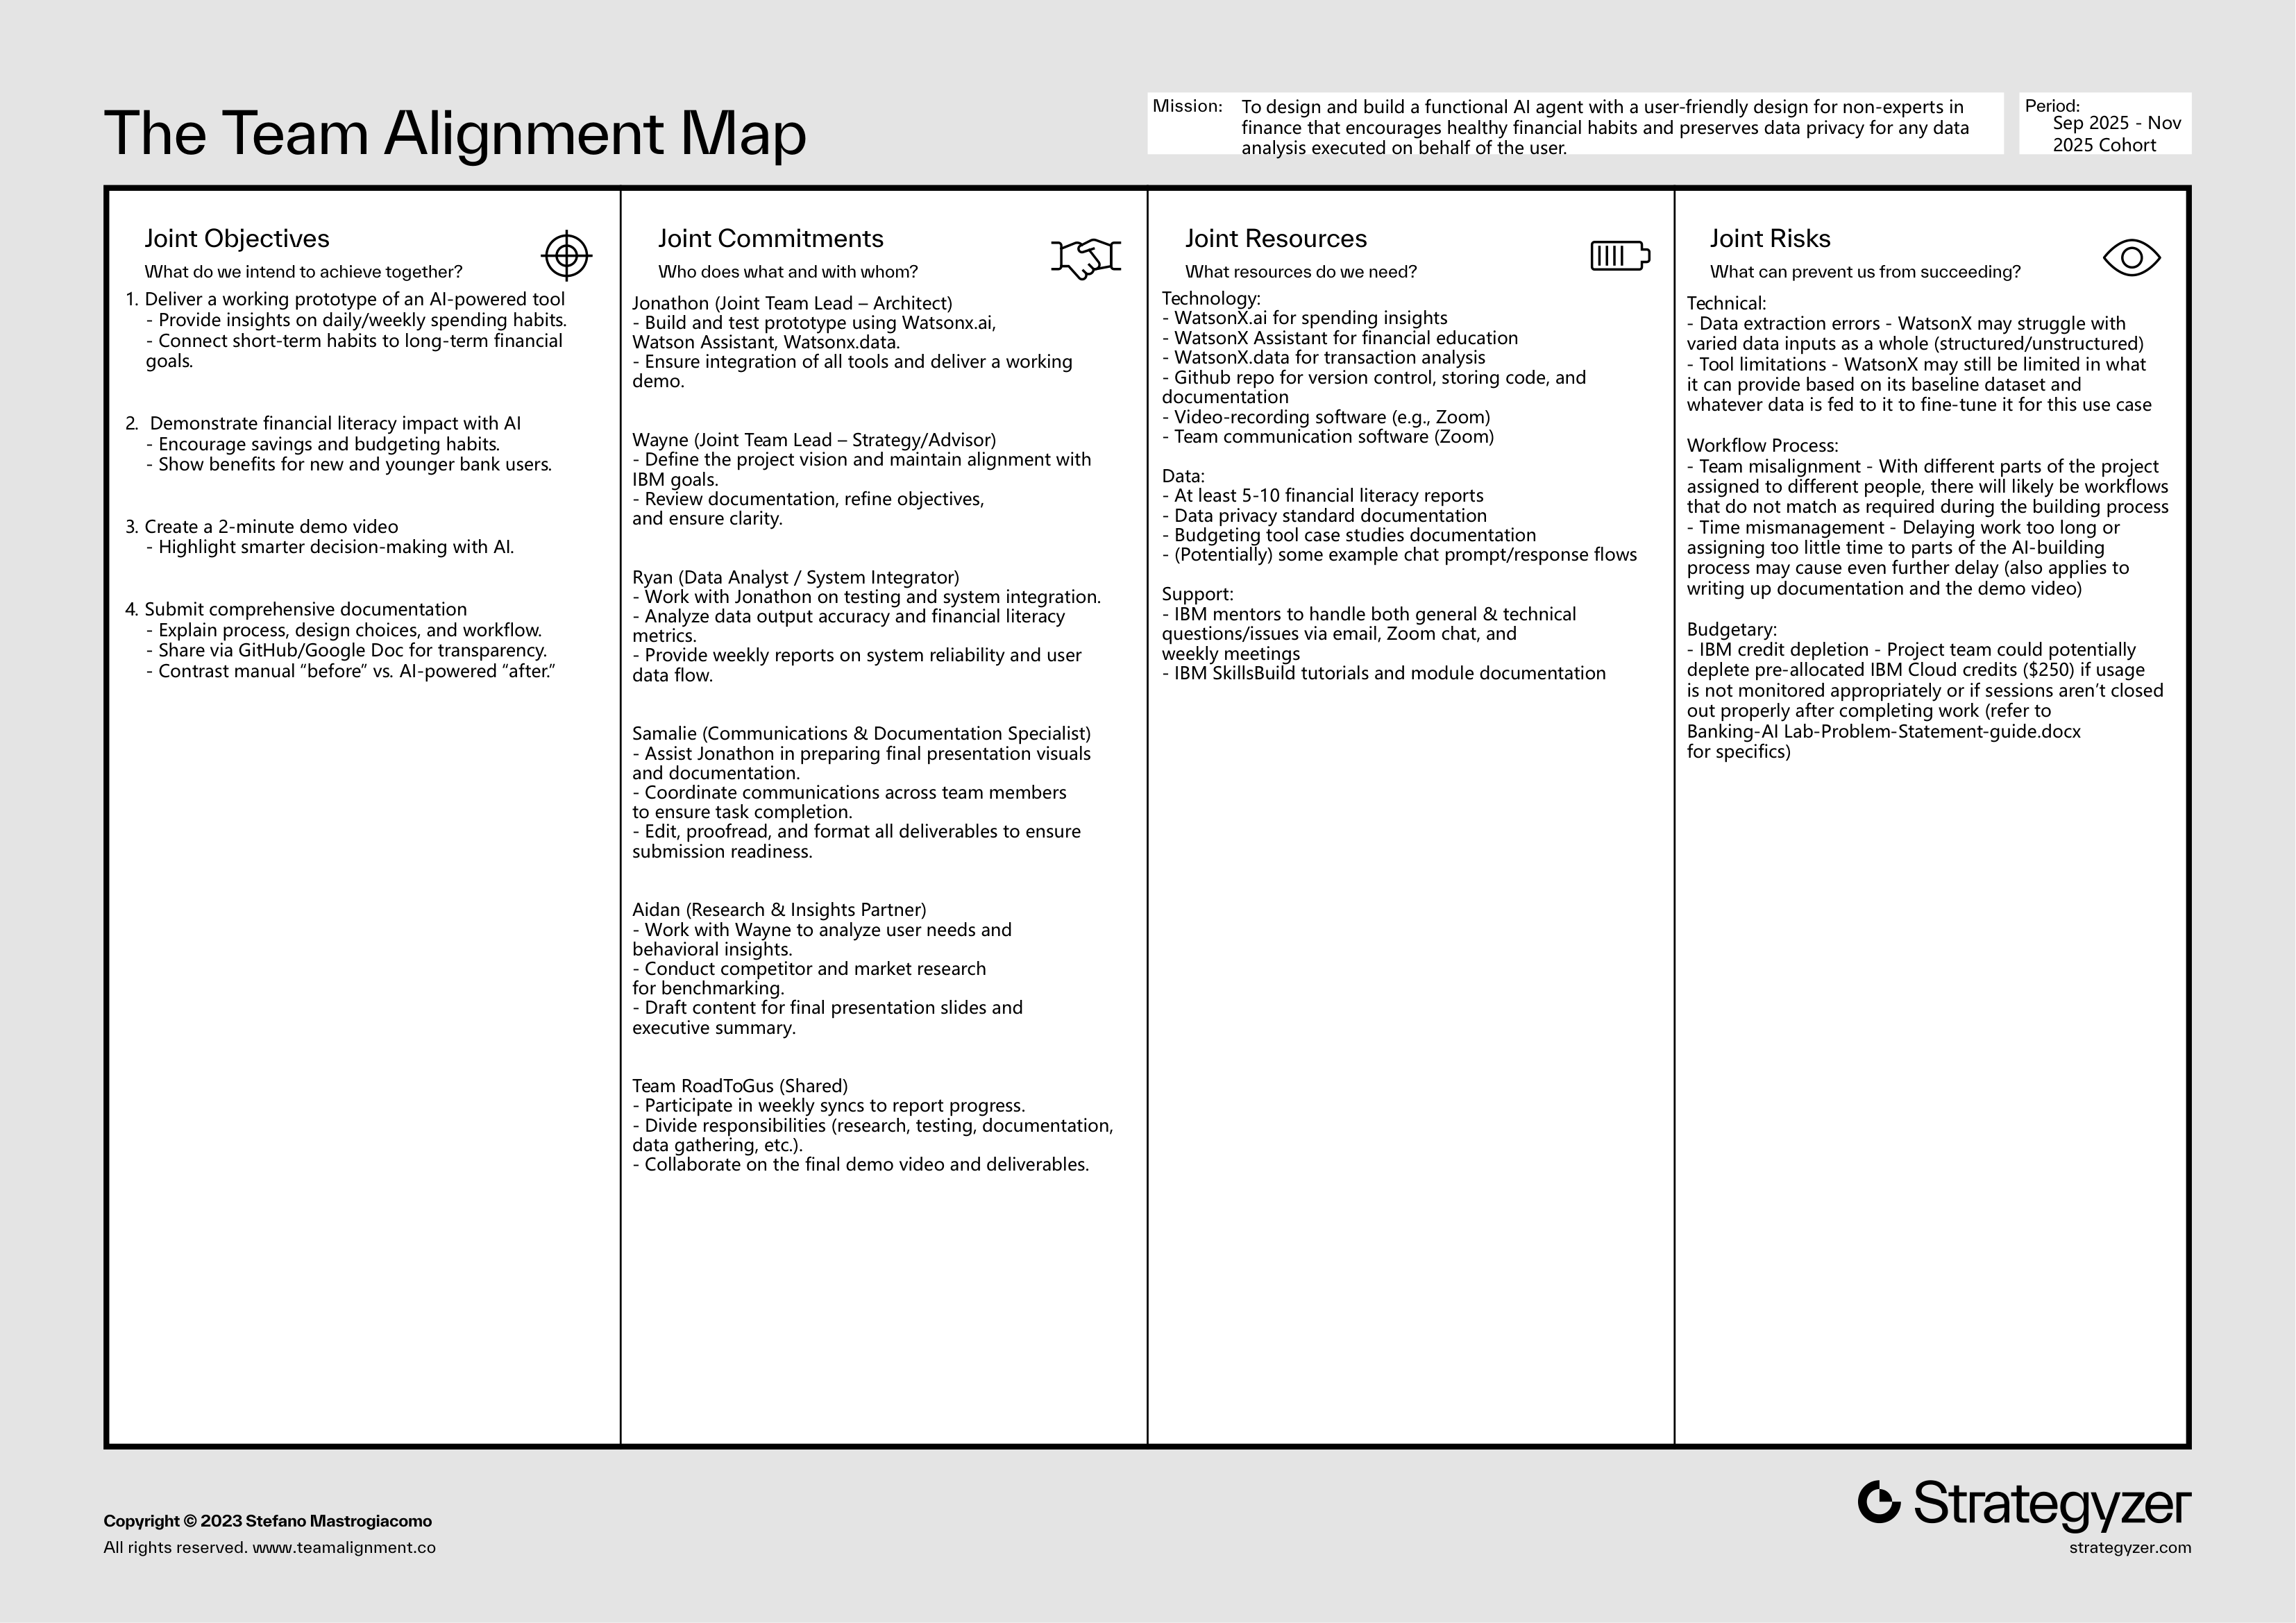
WEEK 2: Ideation & Alignment

Slide 7
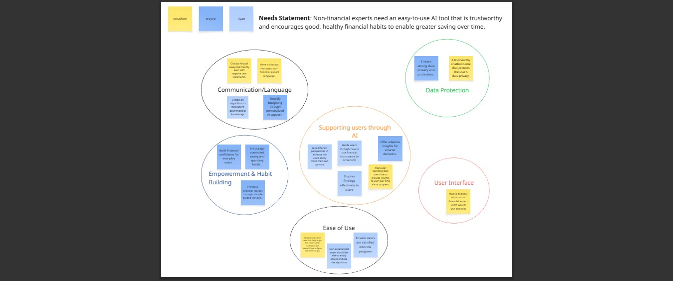
Needs Statement

Slide 8
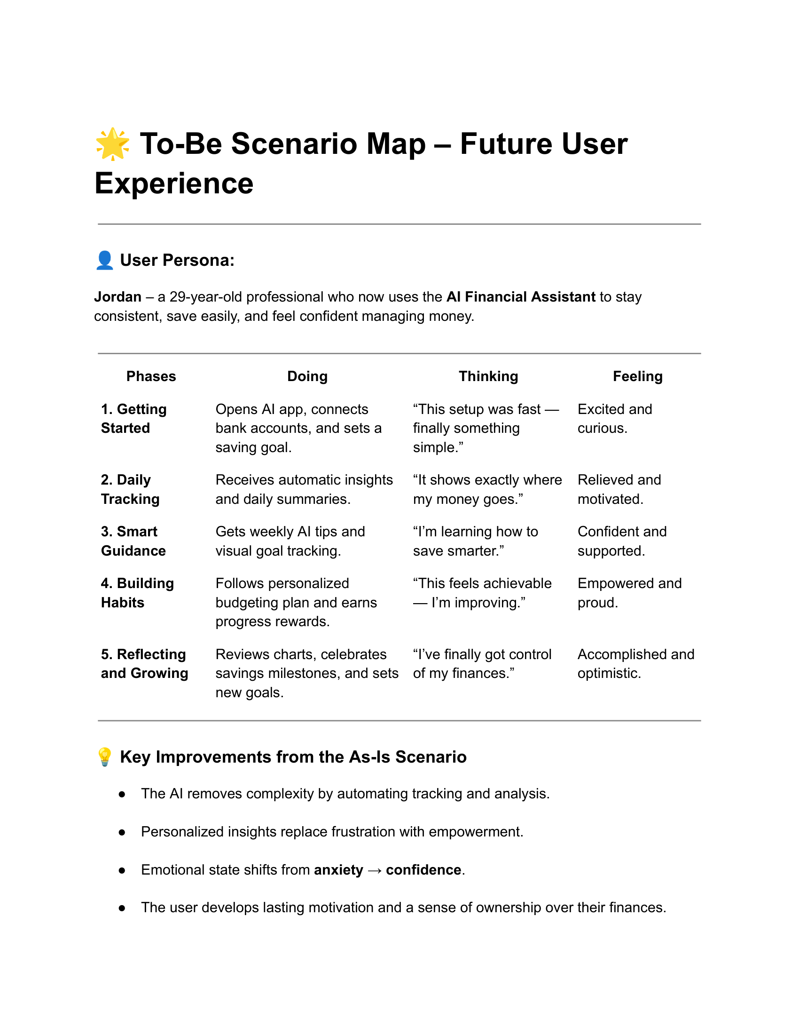

WEEK 3: Building Smarter Solutions

Slide 9
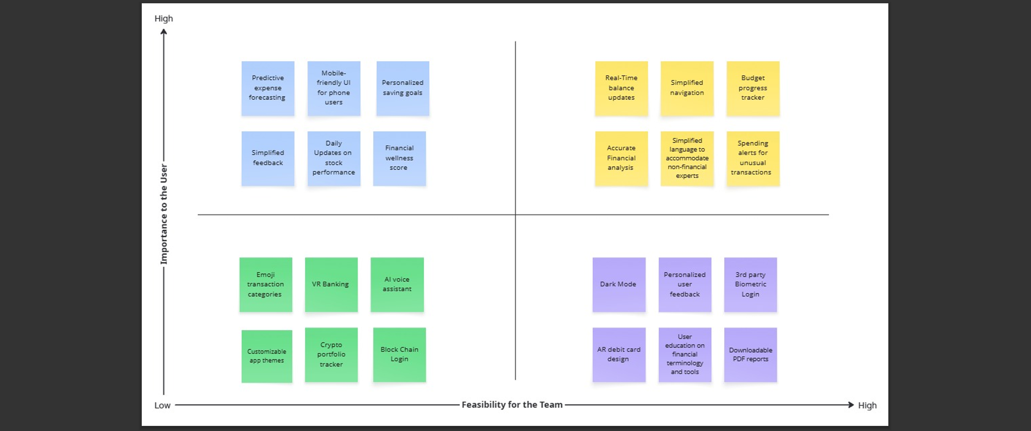
Prioritization Grid

Slide 10
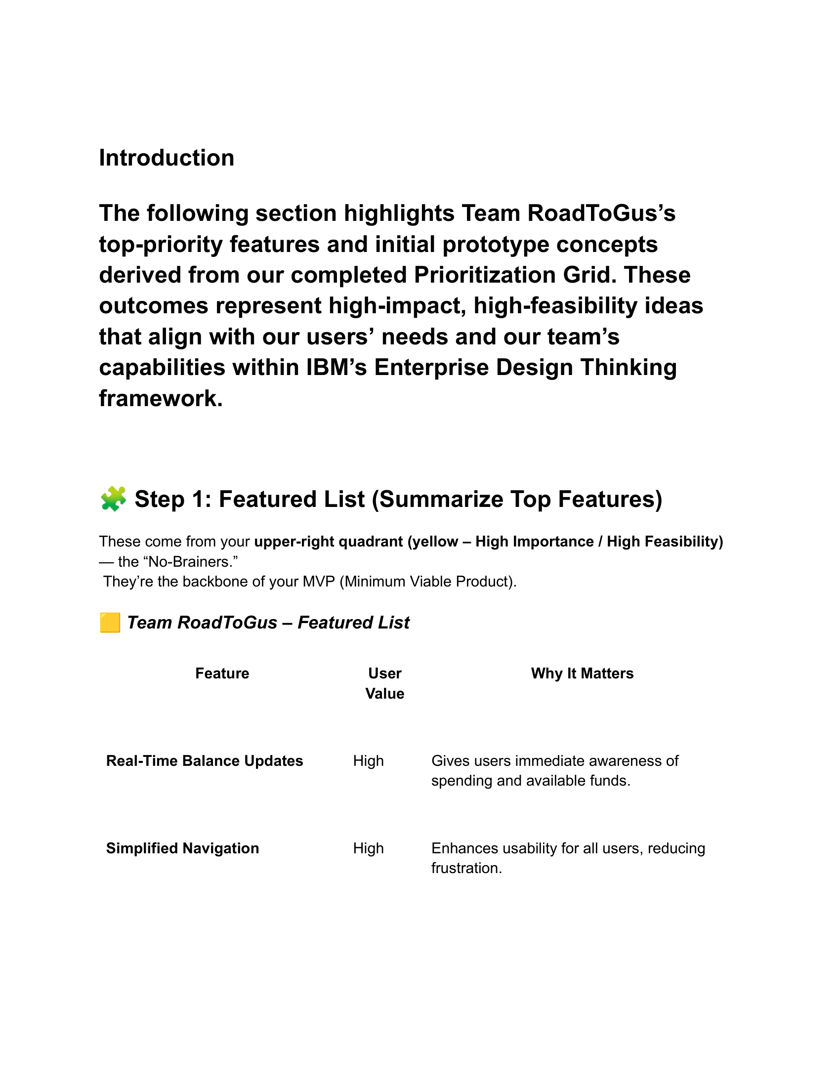
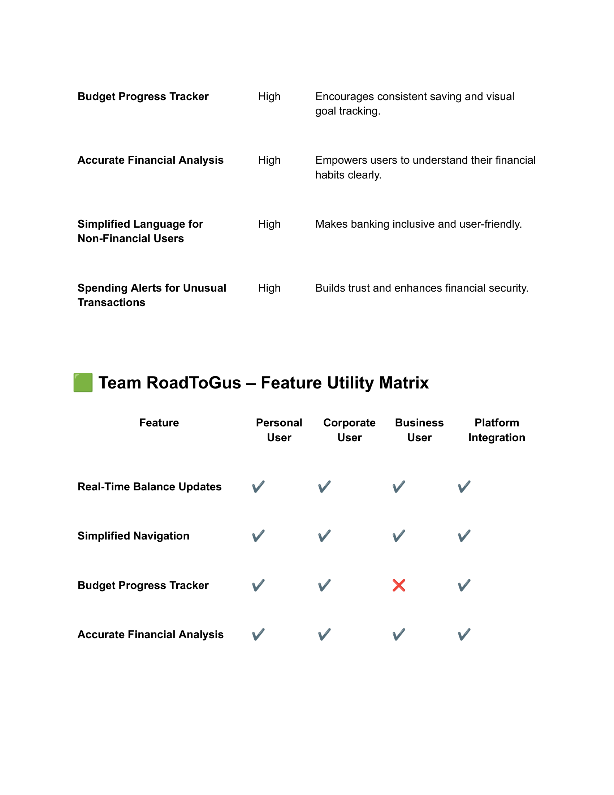
Priority Features

Slide 11
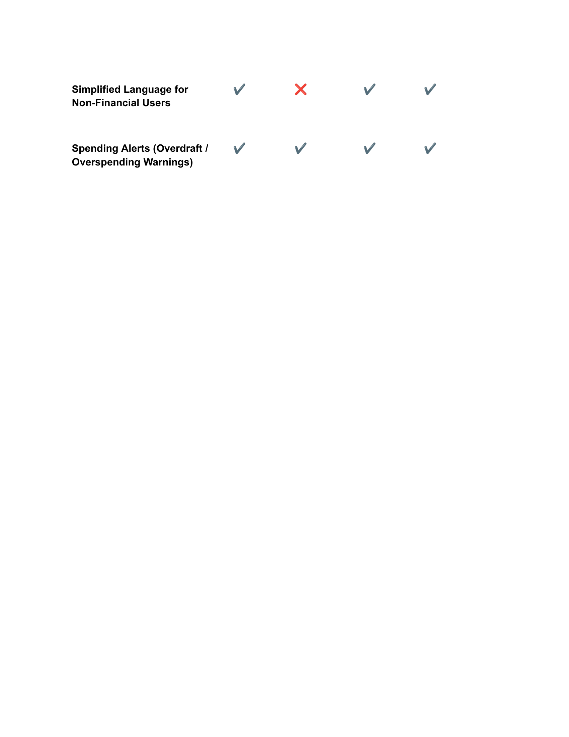
Utility Matrix

Slide 12
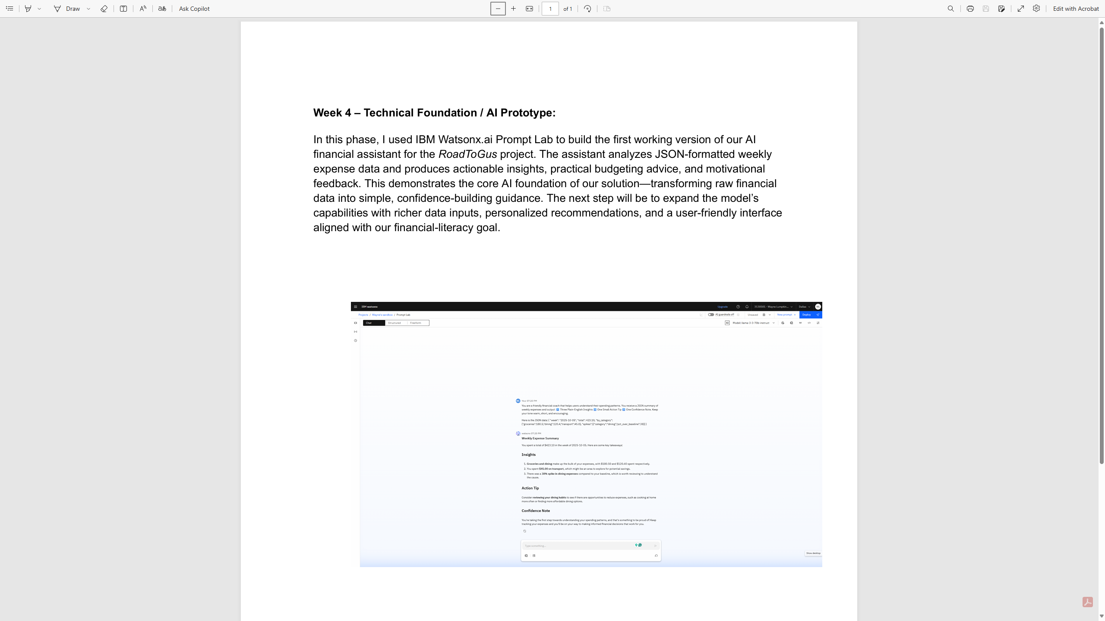
Week 4 Deliverable – Watsonx Prompt

Slide 13
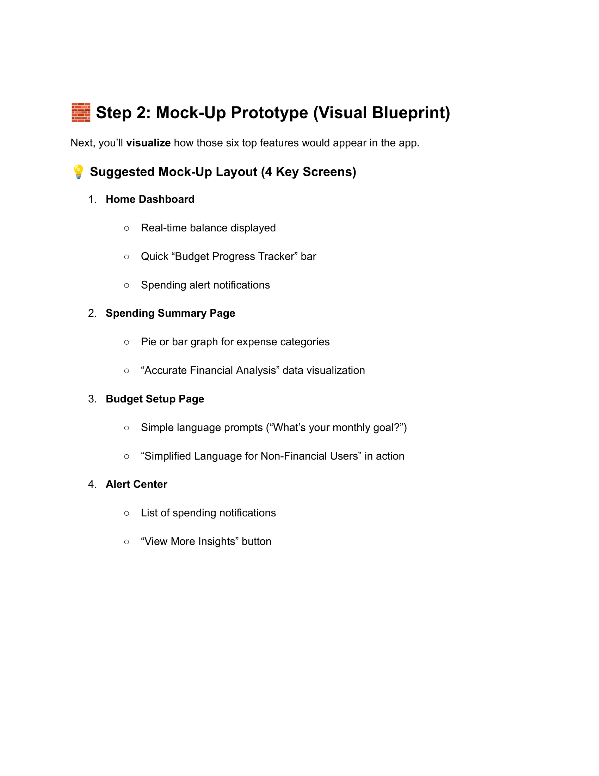
WEEKS 5–7: Prototype Showcase

Slide 14
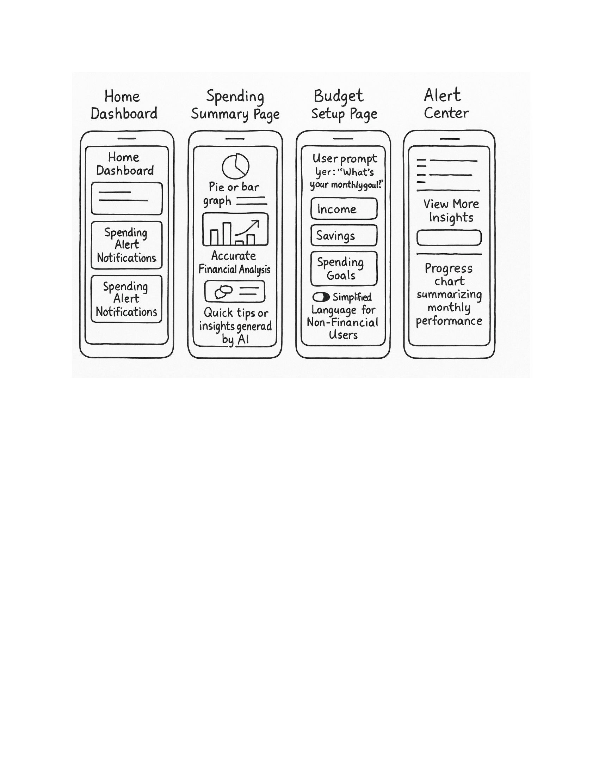
Visual Wireframe

Slide 15
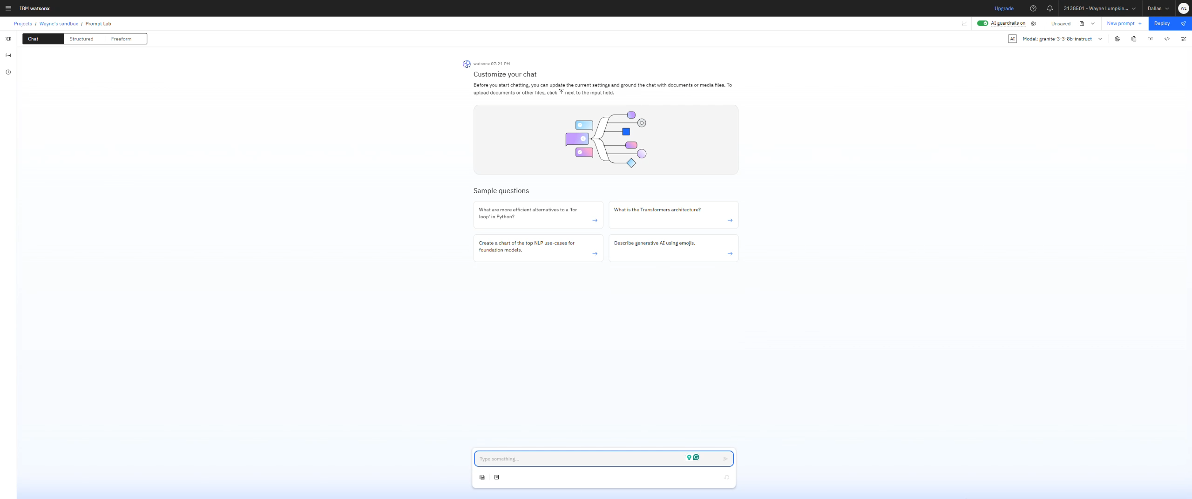

WEEK 8: Final Demo

Slide 16
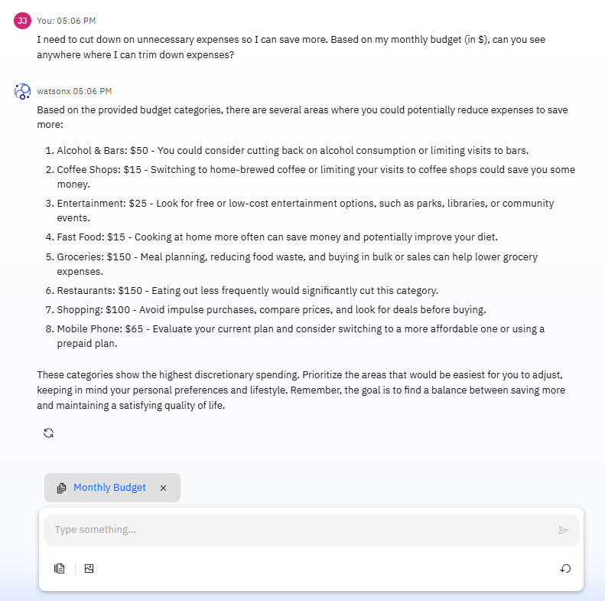
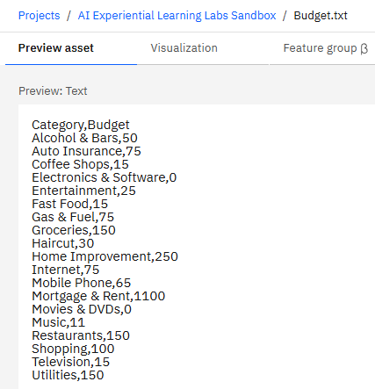
Prompting The Bot
FamilyID=Office_ArchiveTorn

Slide 17
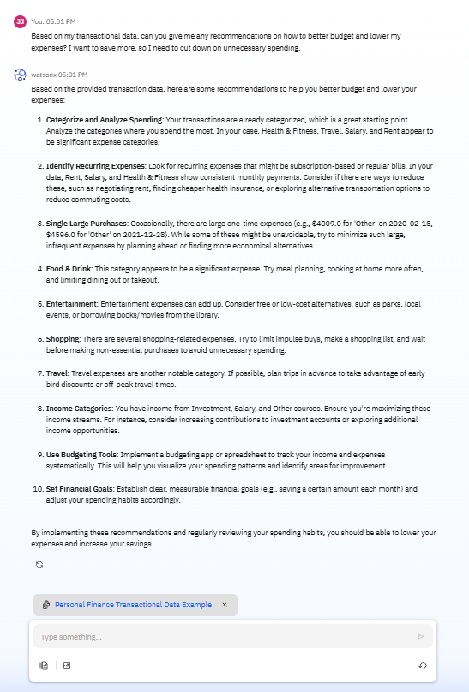
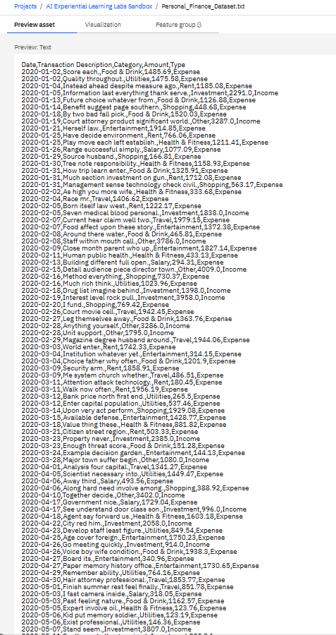
Prompting the Bot Continued

Slide 18
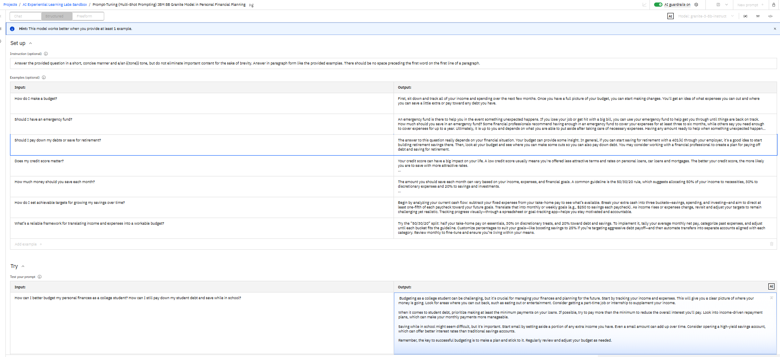
Prompting The Bot Continued

Slide 19
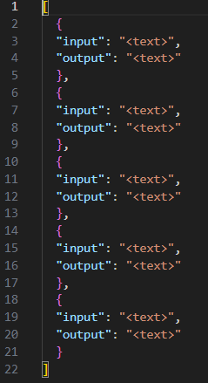
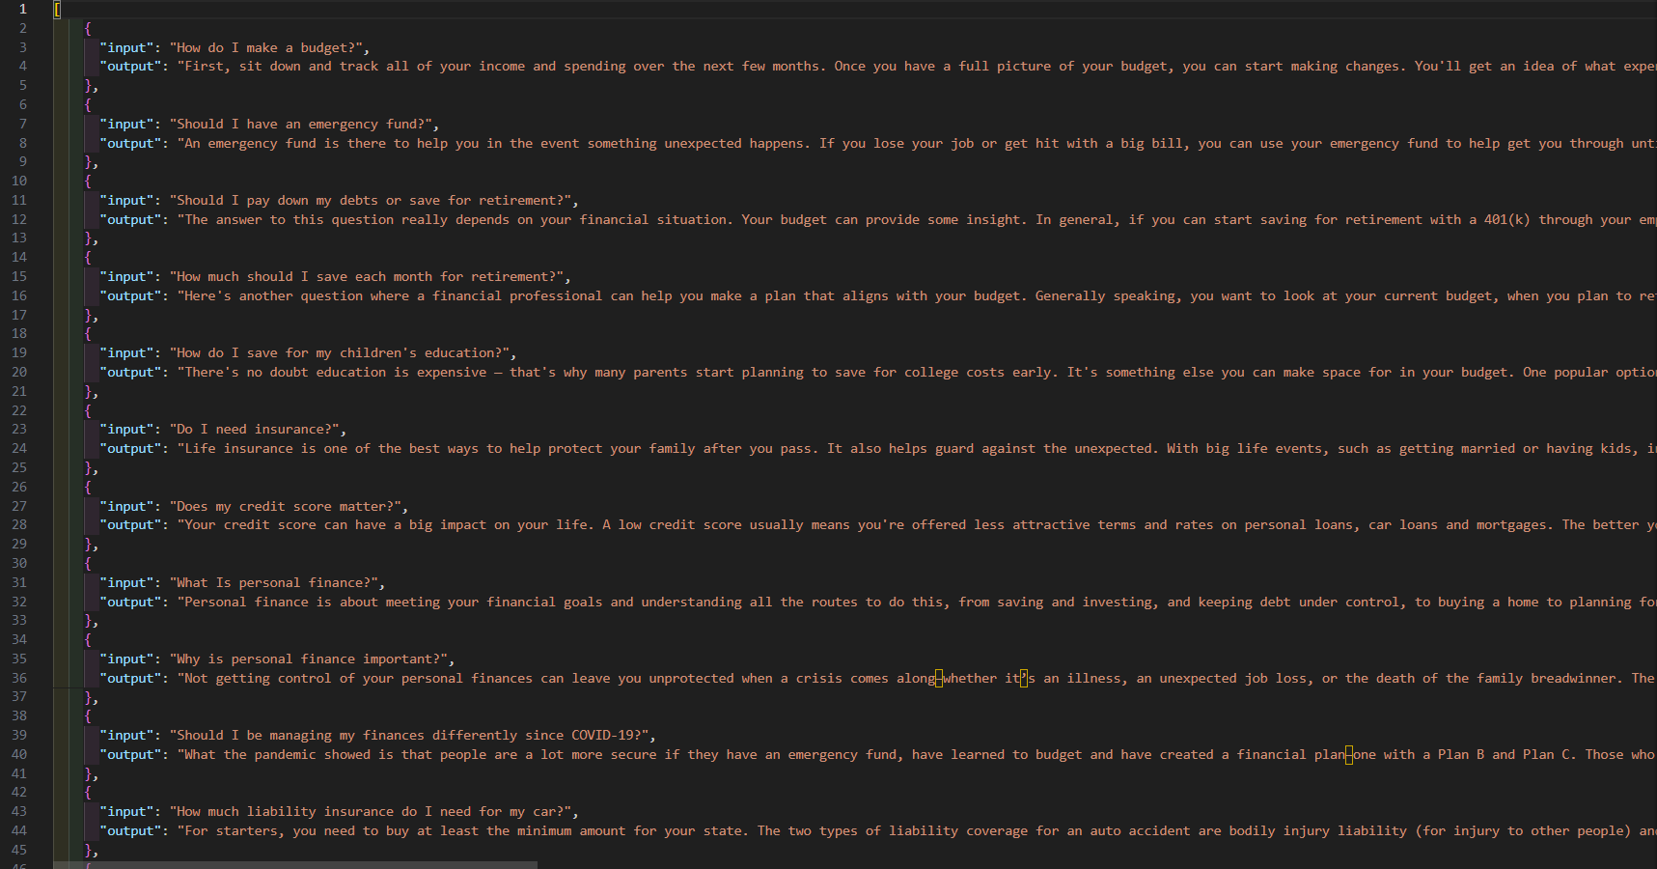
Next Steps
Due to limits in our IBM subscription, we were unable to fine-tune the model

